Slide 1
MTrack2
MSD
Plot
Brownian Motion Observation
Means of computation
MTrack2(ImageJ)
Cross correlation(MATLAB)
Means of compute
EXCEL
Pandas, SciPy (Python)
Matrix (MATLAB)
Means of compute
EXCEL
Matplotlib (Python)
Figure (MATLAB)

Slide 2
MTrack2
MSD
Plot
Brownian Motion Observation
Means of compute
MTrack2(ImageJ)
Cross correlation(MATLAB)
Means of computation
EXCEL
Pandas, SciPy (Python)
Matrix (MATLAB)
Means of compute
EXCEL
Matplotlib (Python)
Figure (MATLAB)

Slide 3
MTrack2
MSD
Plot
Brownian Motion Observation
Means of compute
MTrack2(ImageJ)
Cross correlation(MATLAB)
Means of compute
EXCEL
Pandas, SciPy (Python)
Matrix (MATLAB)
Means of computation
EXCEL
Matplotlib (Python)
Figure (MATLAB)

Slide 4
MTrack2
MSD
Plot
Brownian Motion Observation
Means of computation
MTrack2(ImageJ)
Cross correlation(MATLAB)
Means of computation
EXCEL
Pandas, SciPy (Python)
Matrix (MATLAB)
Means of computation
EXCEL
Matplotlib (Python)
Figure (MATLAB)
Future works: Integrate the whole analysis process via MATLAB

Slide 5
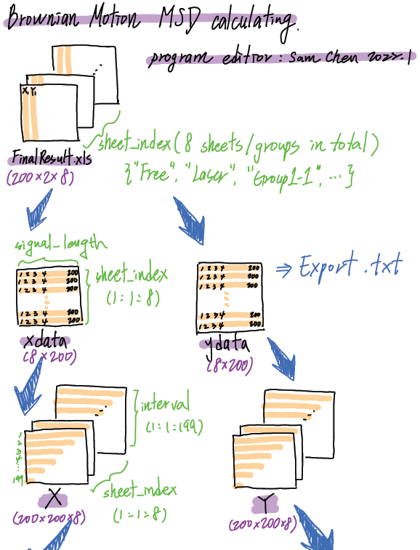
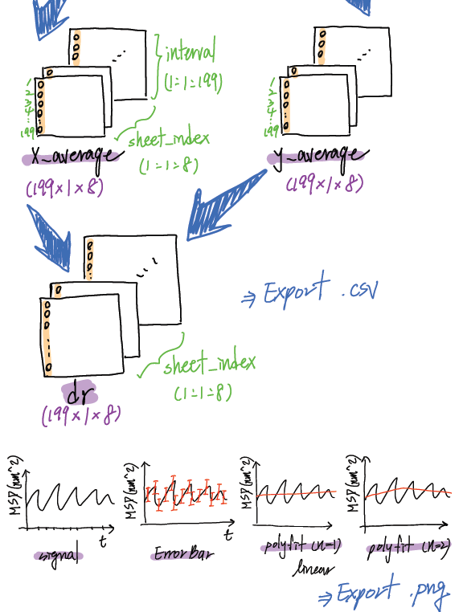

Slide 6
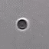
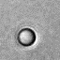
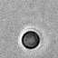
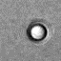
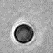
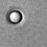

Slide 7
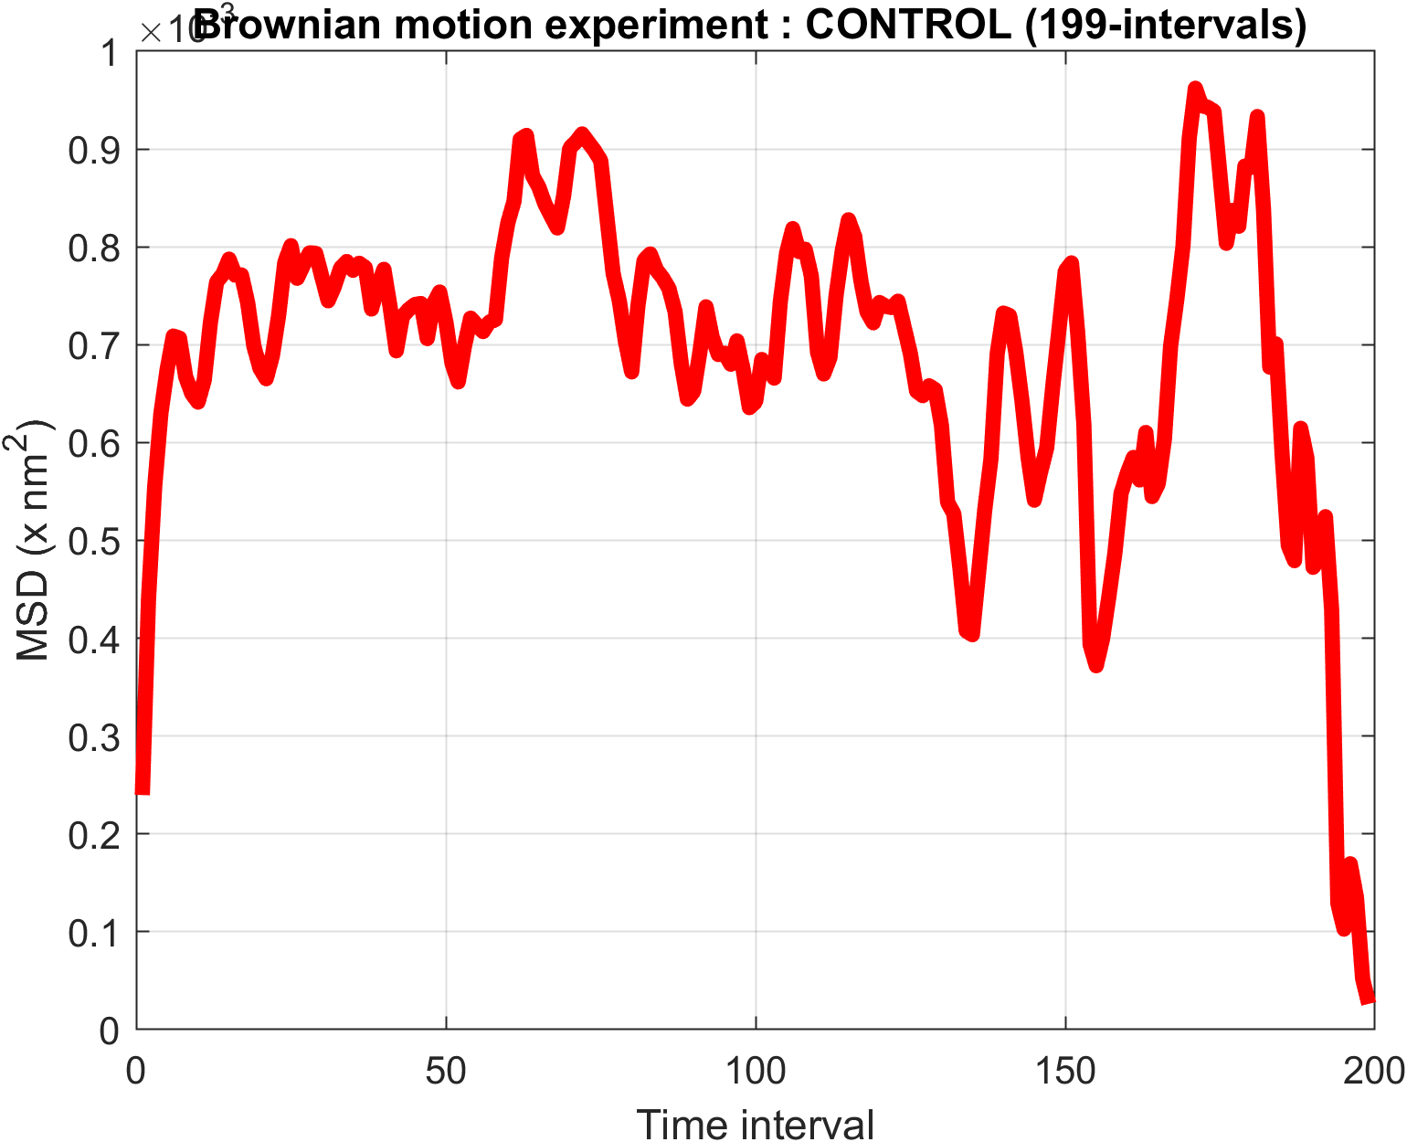
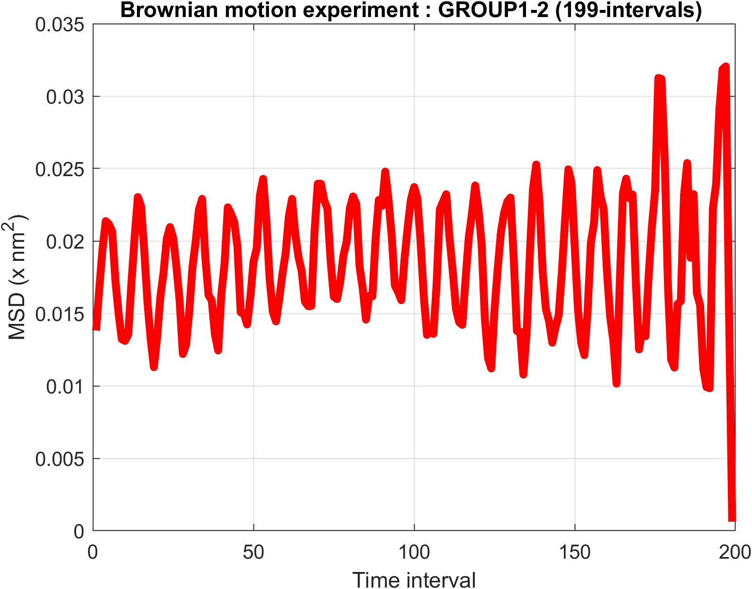
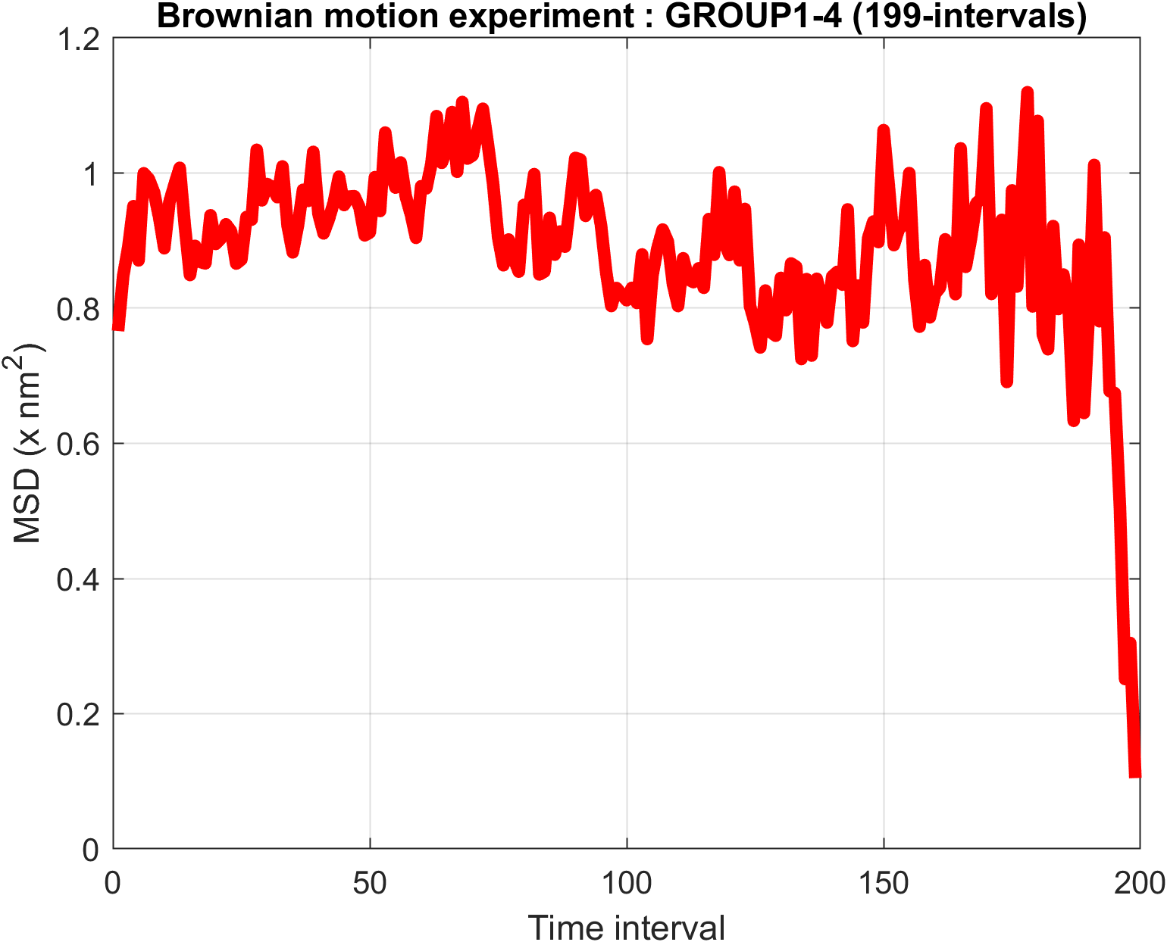
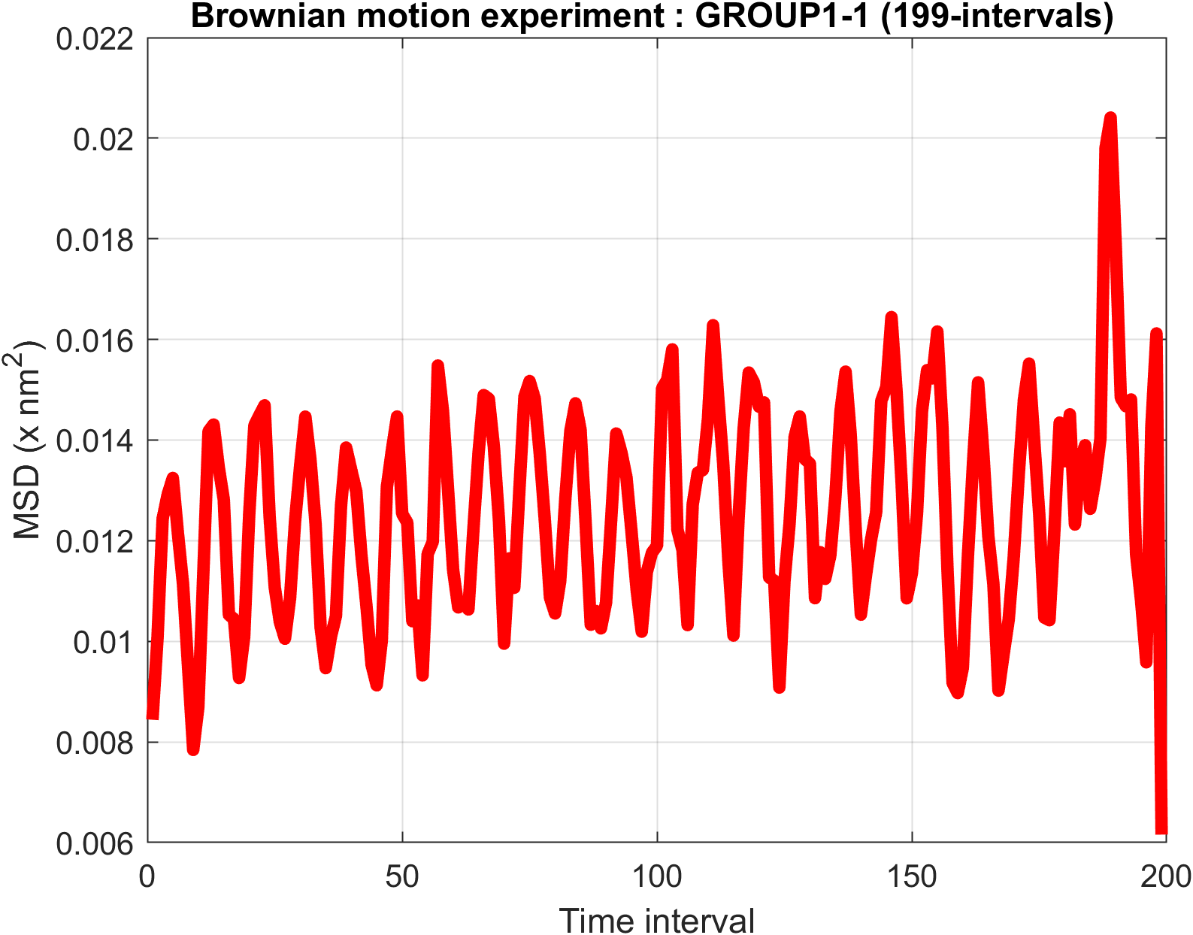
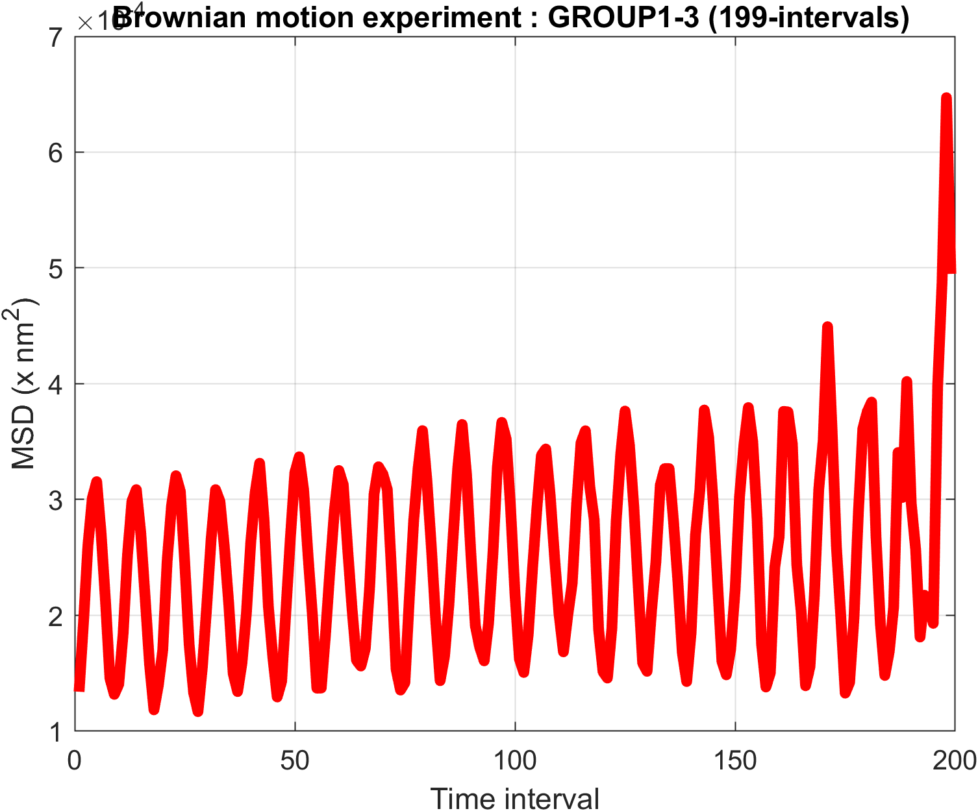
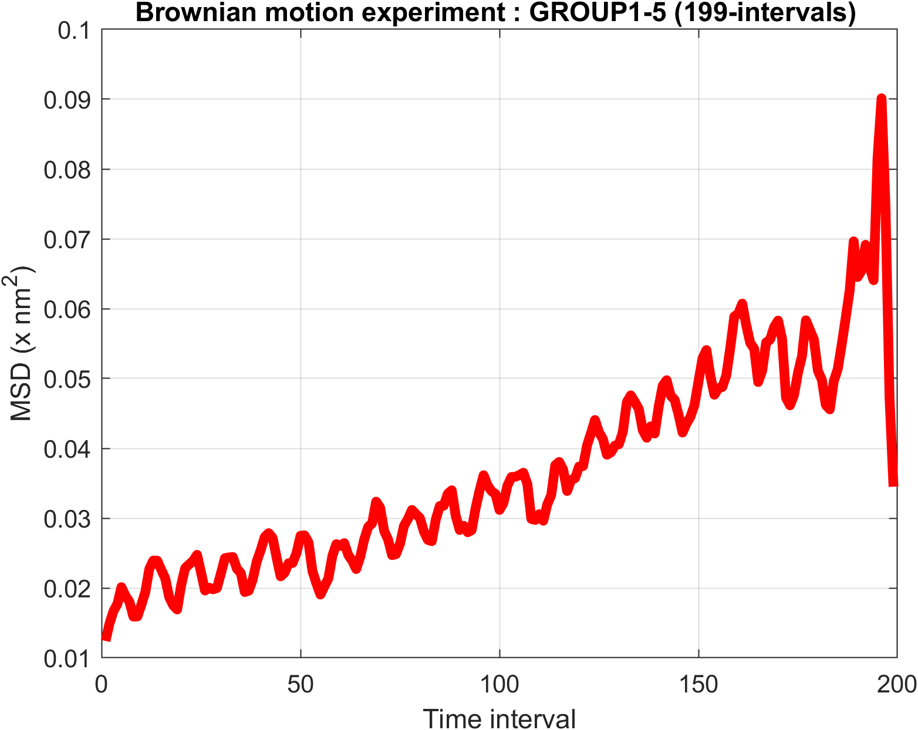

Slide 8
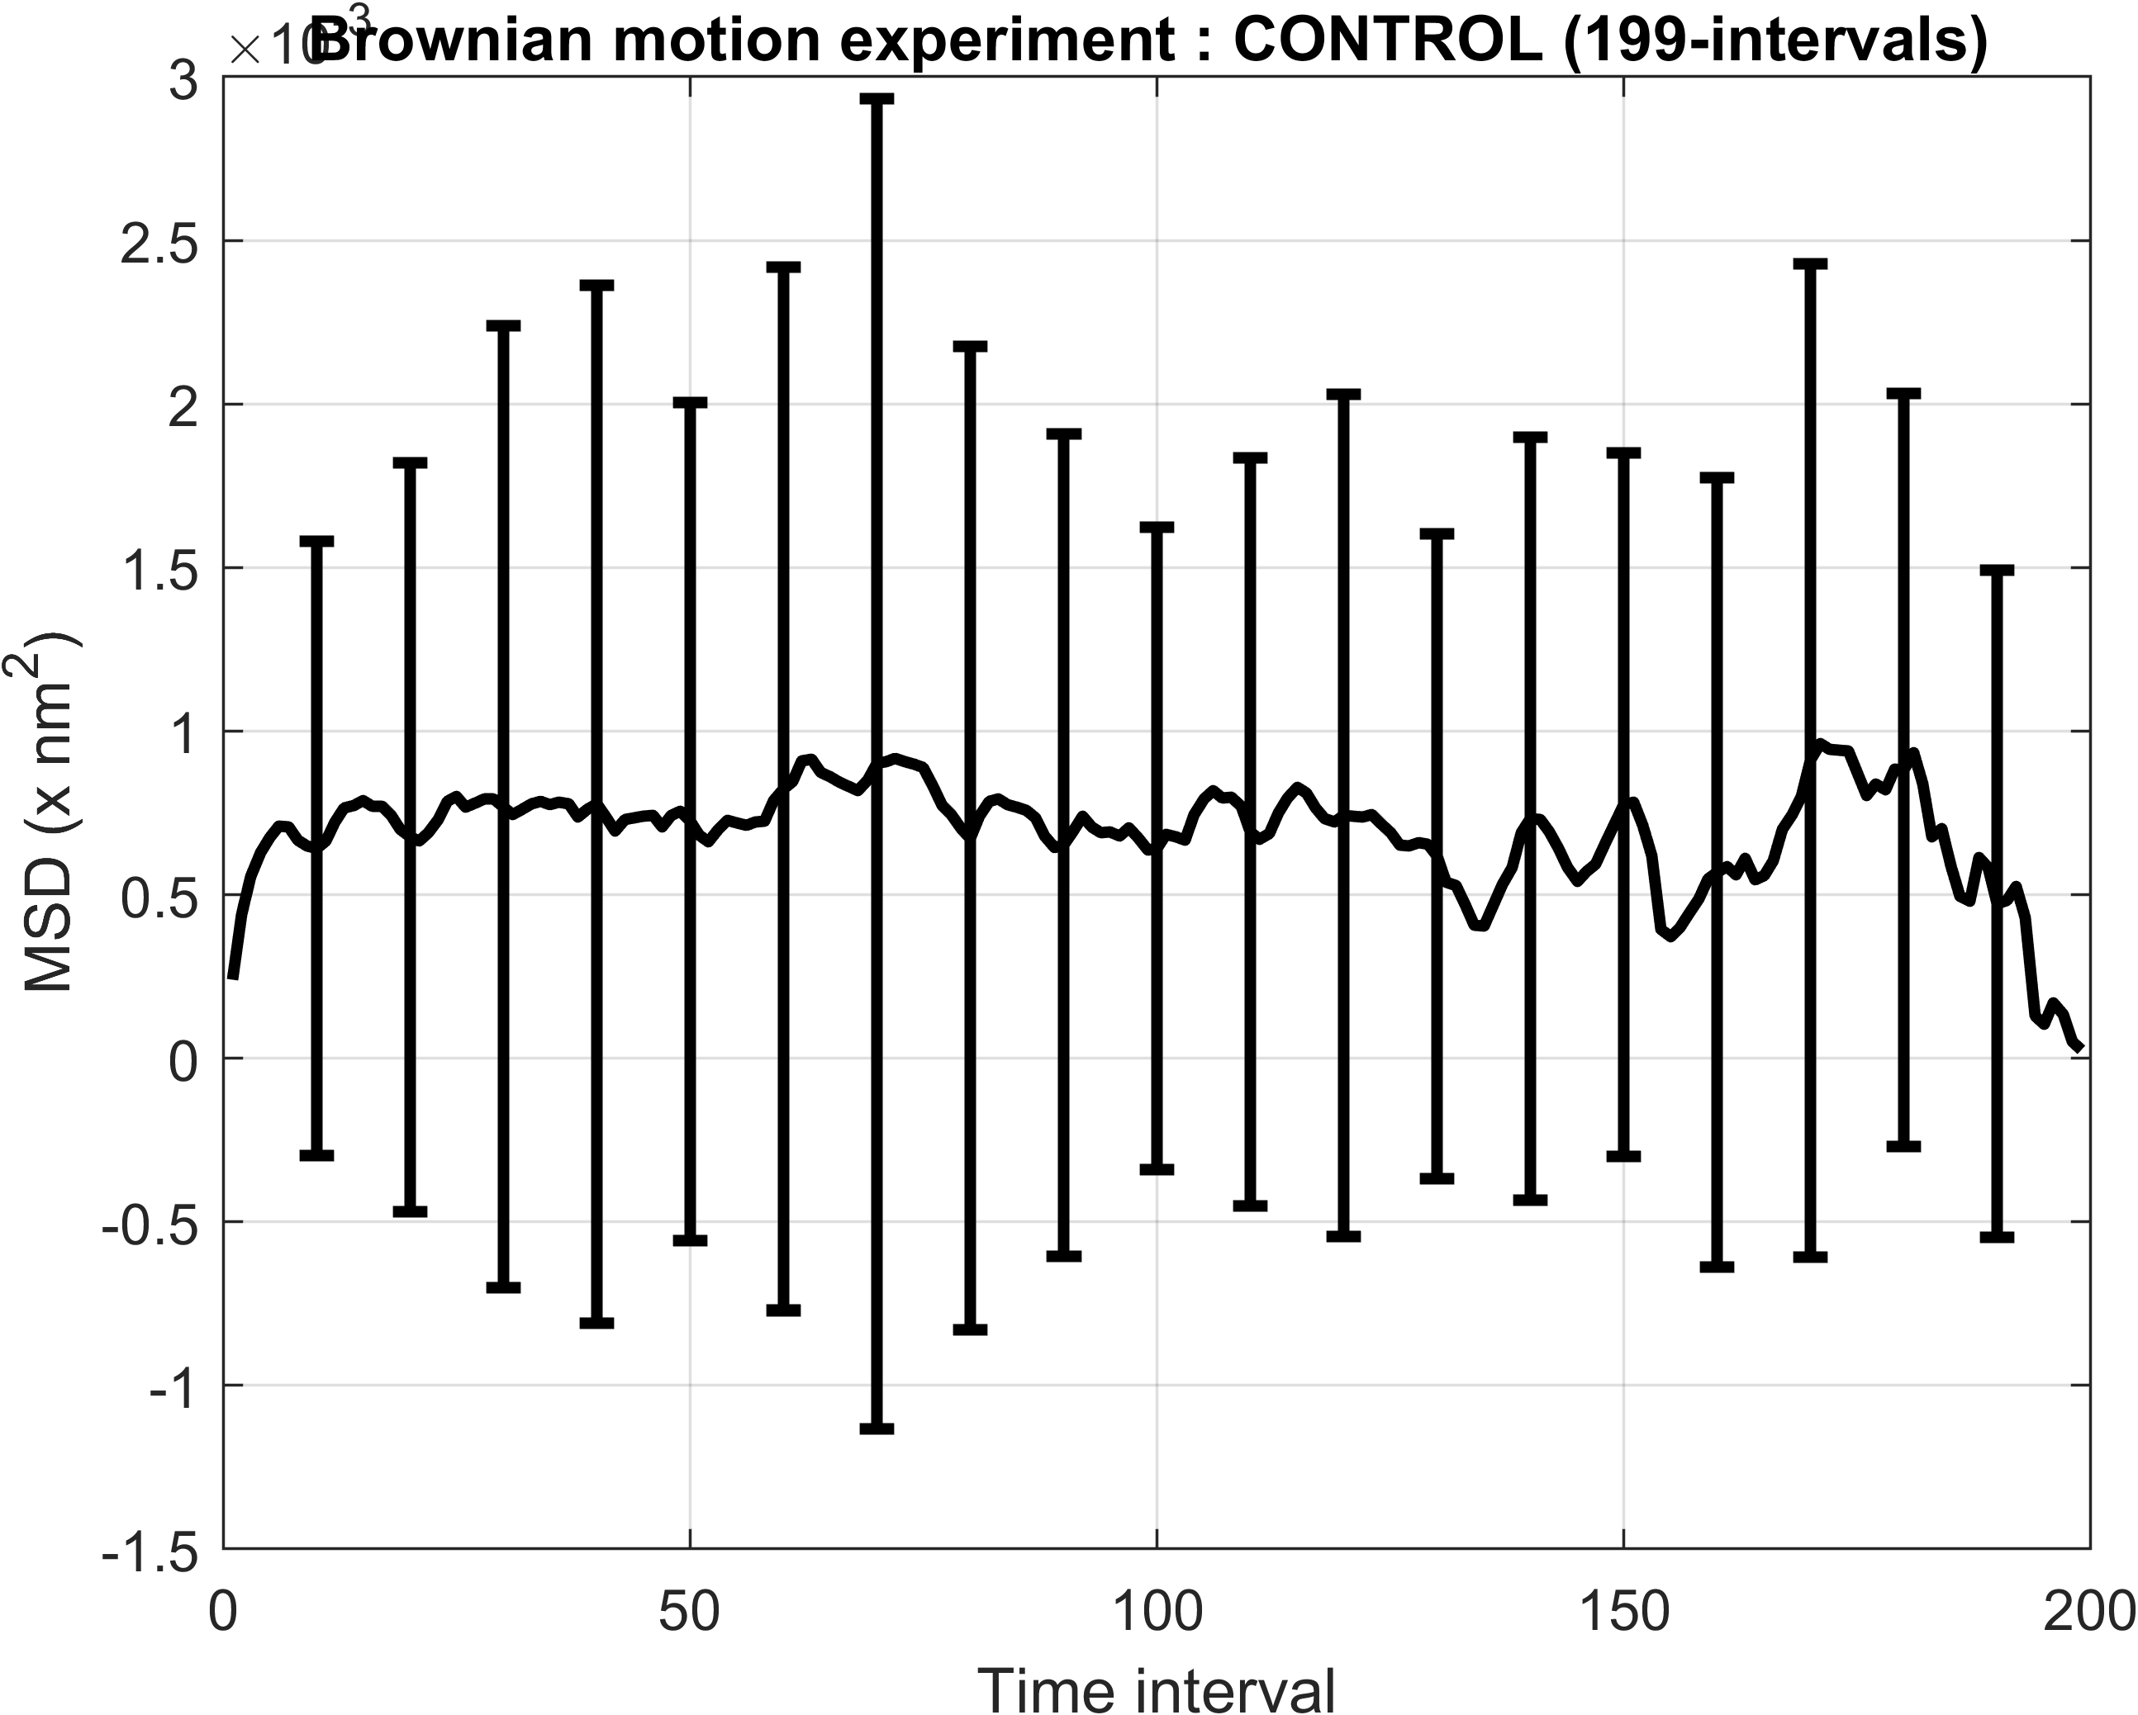
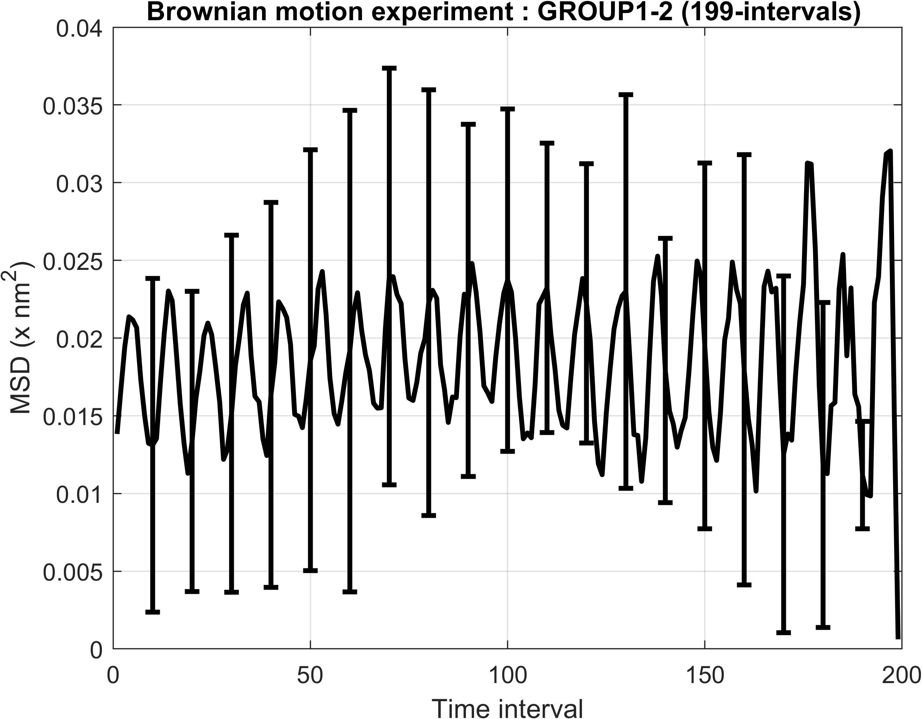
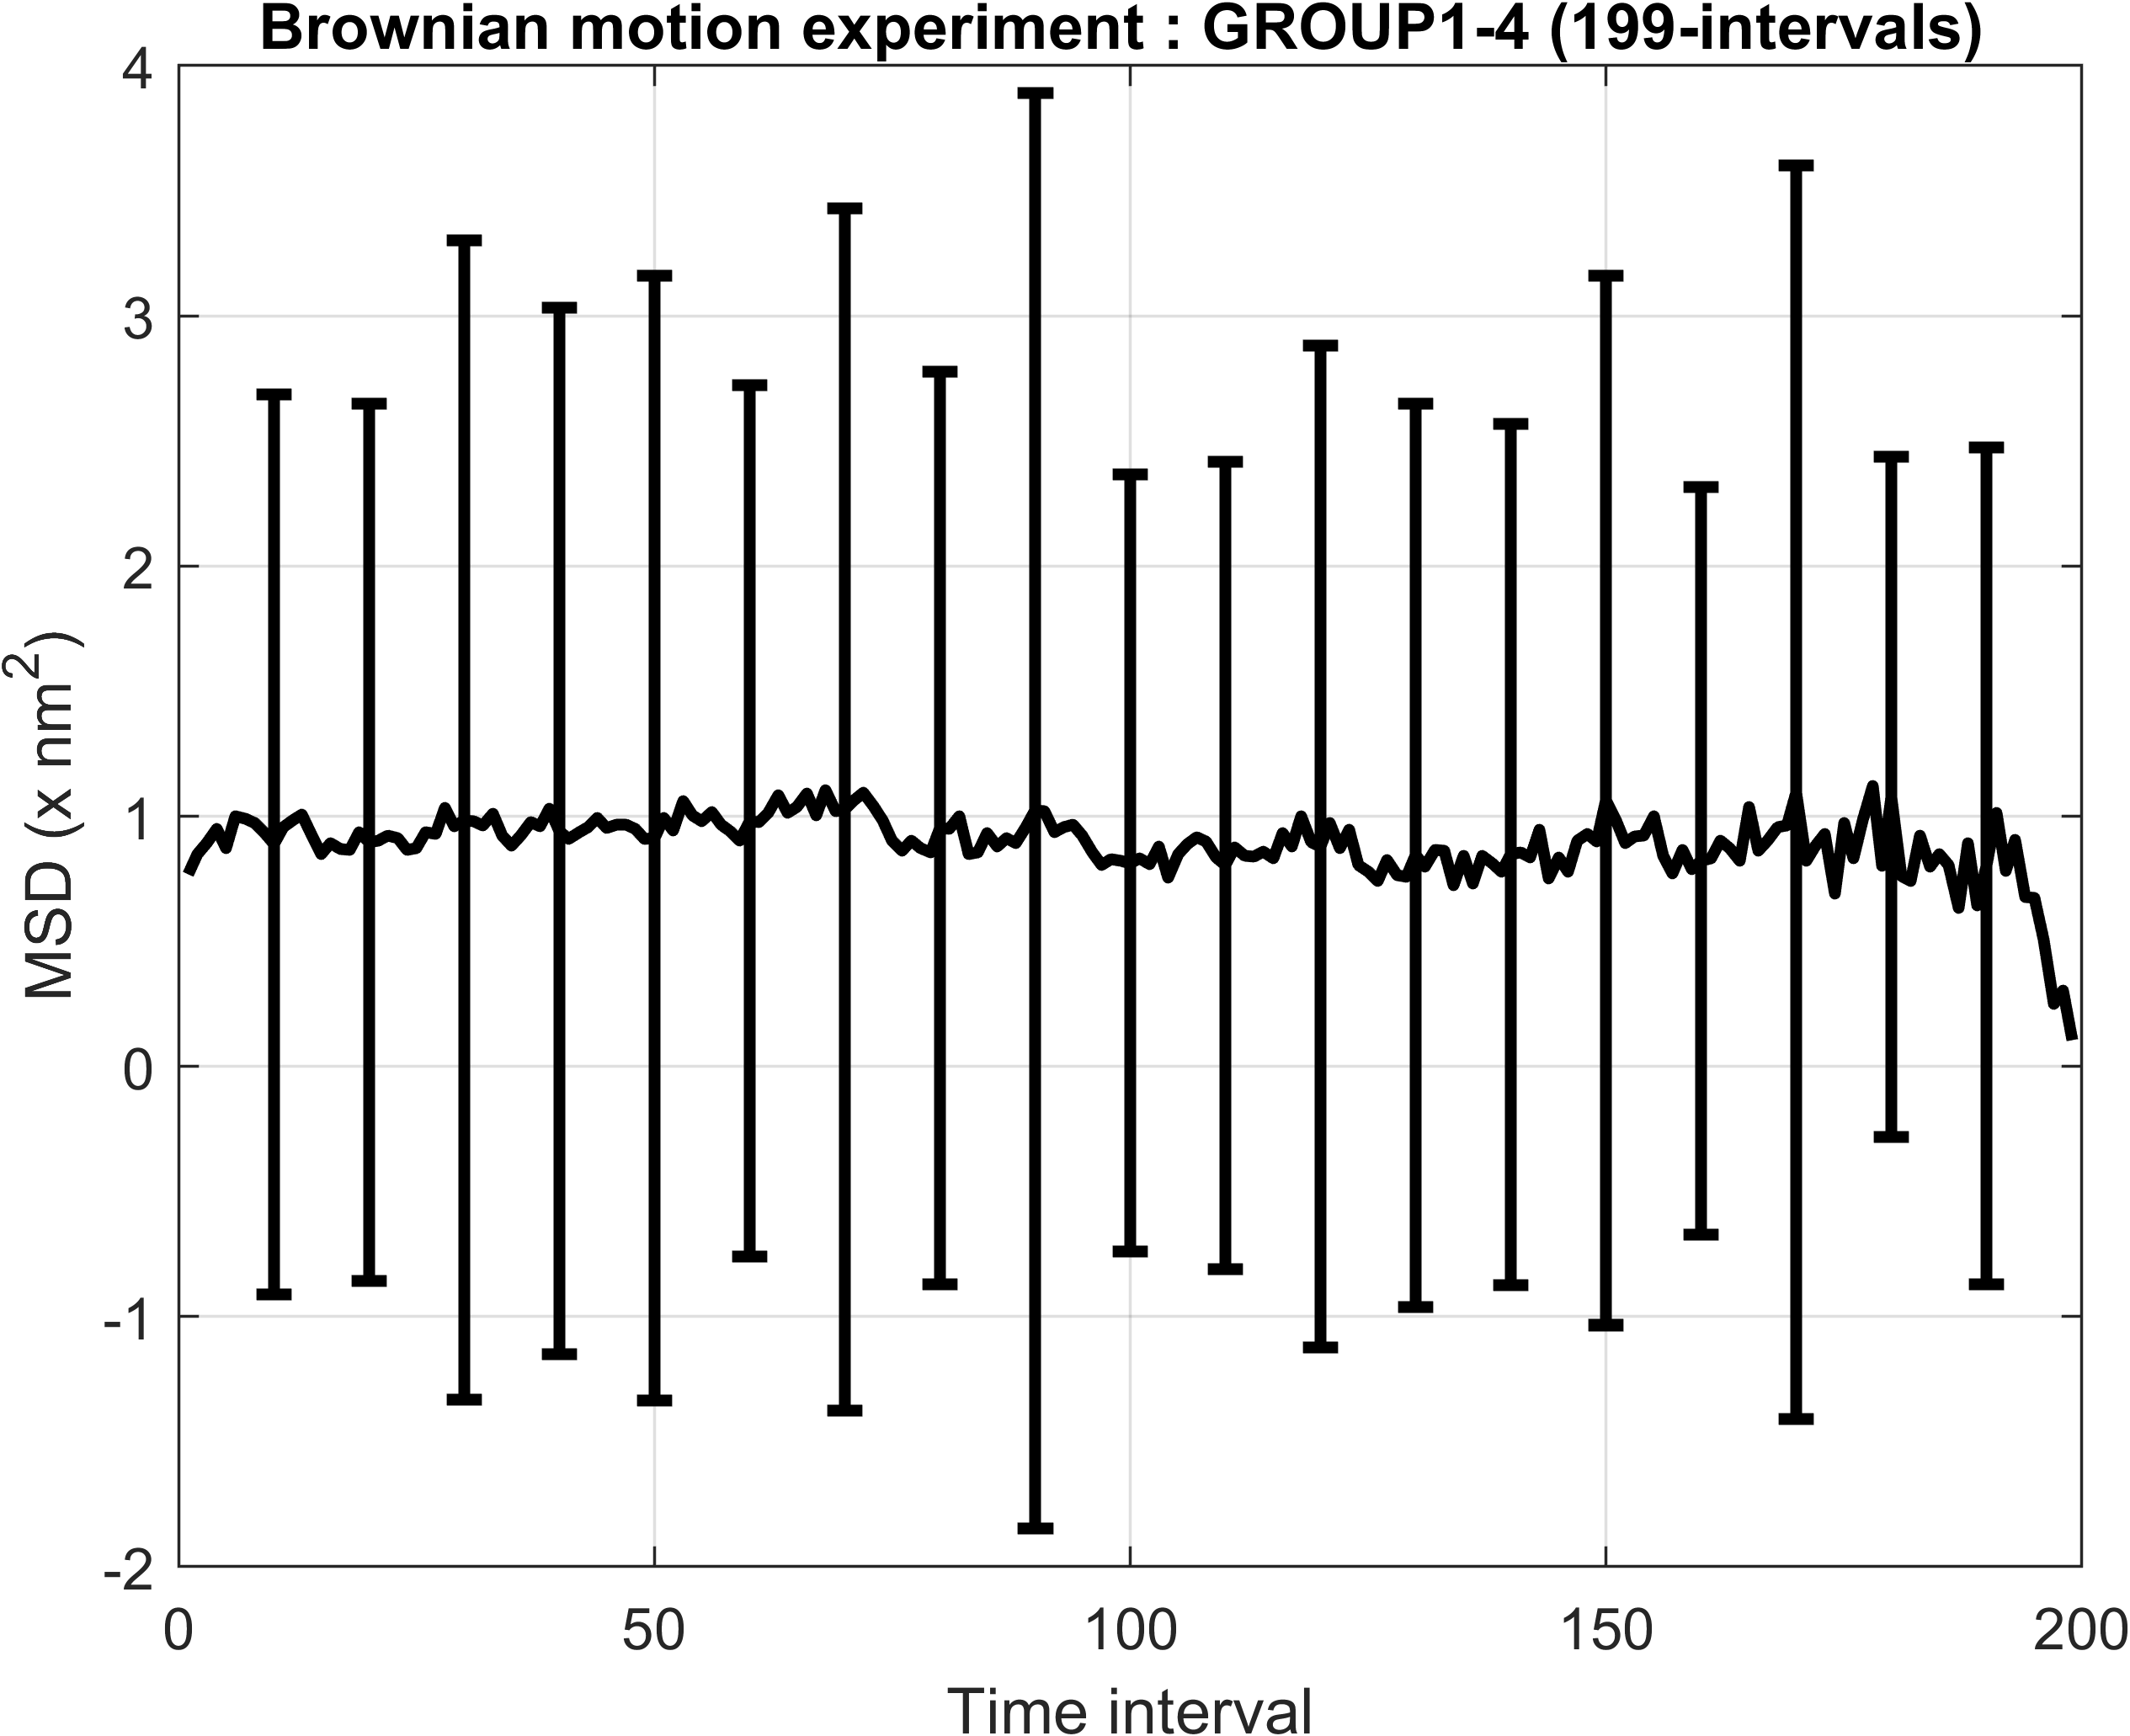
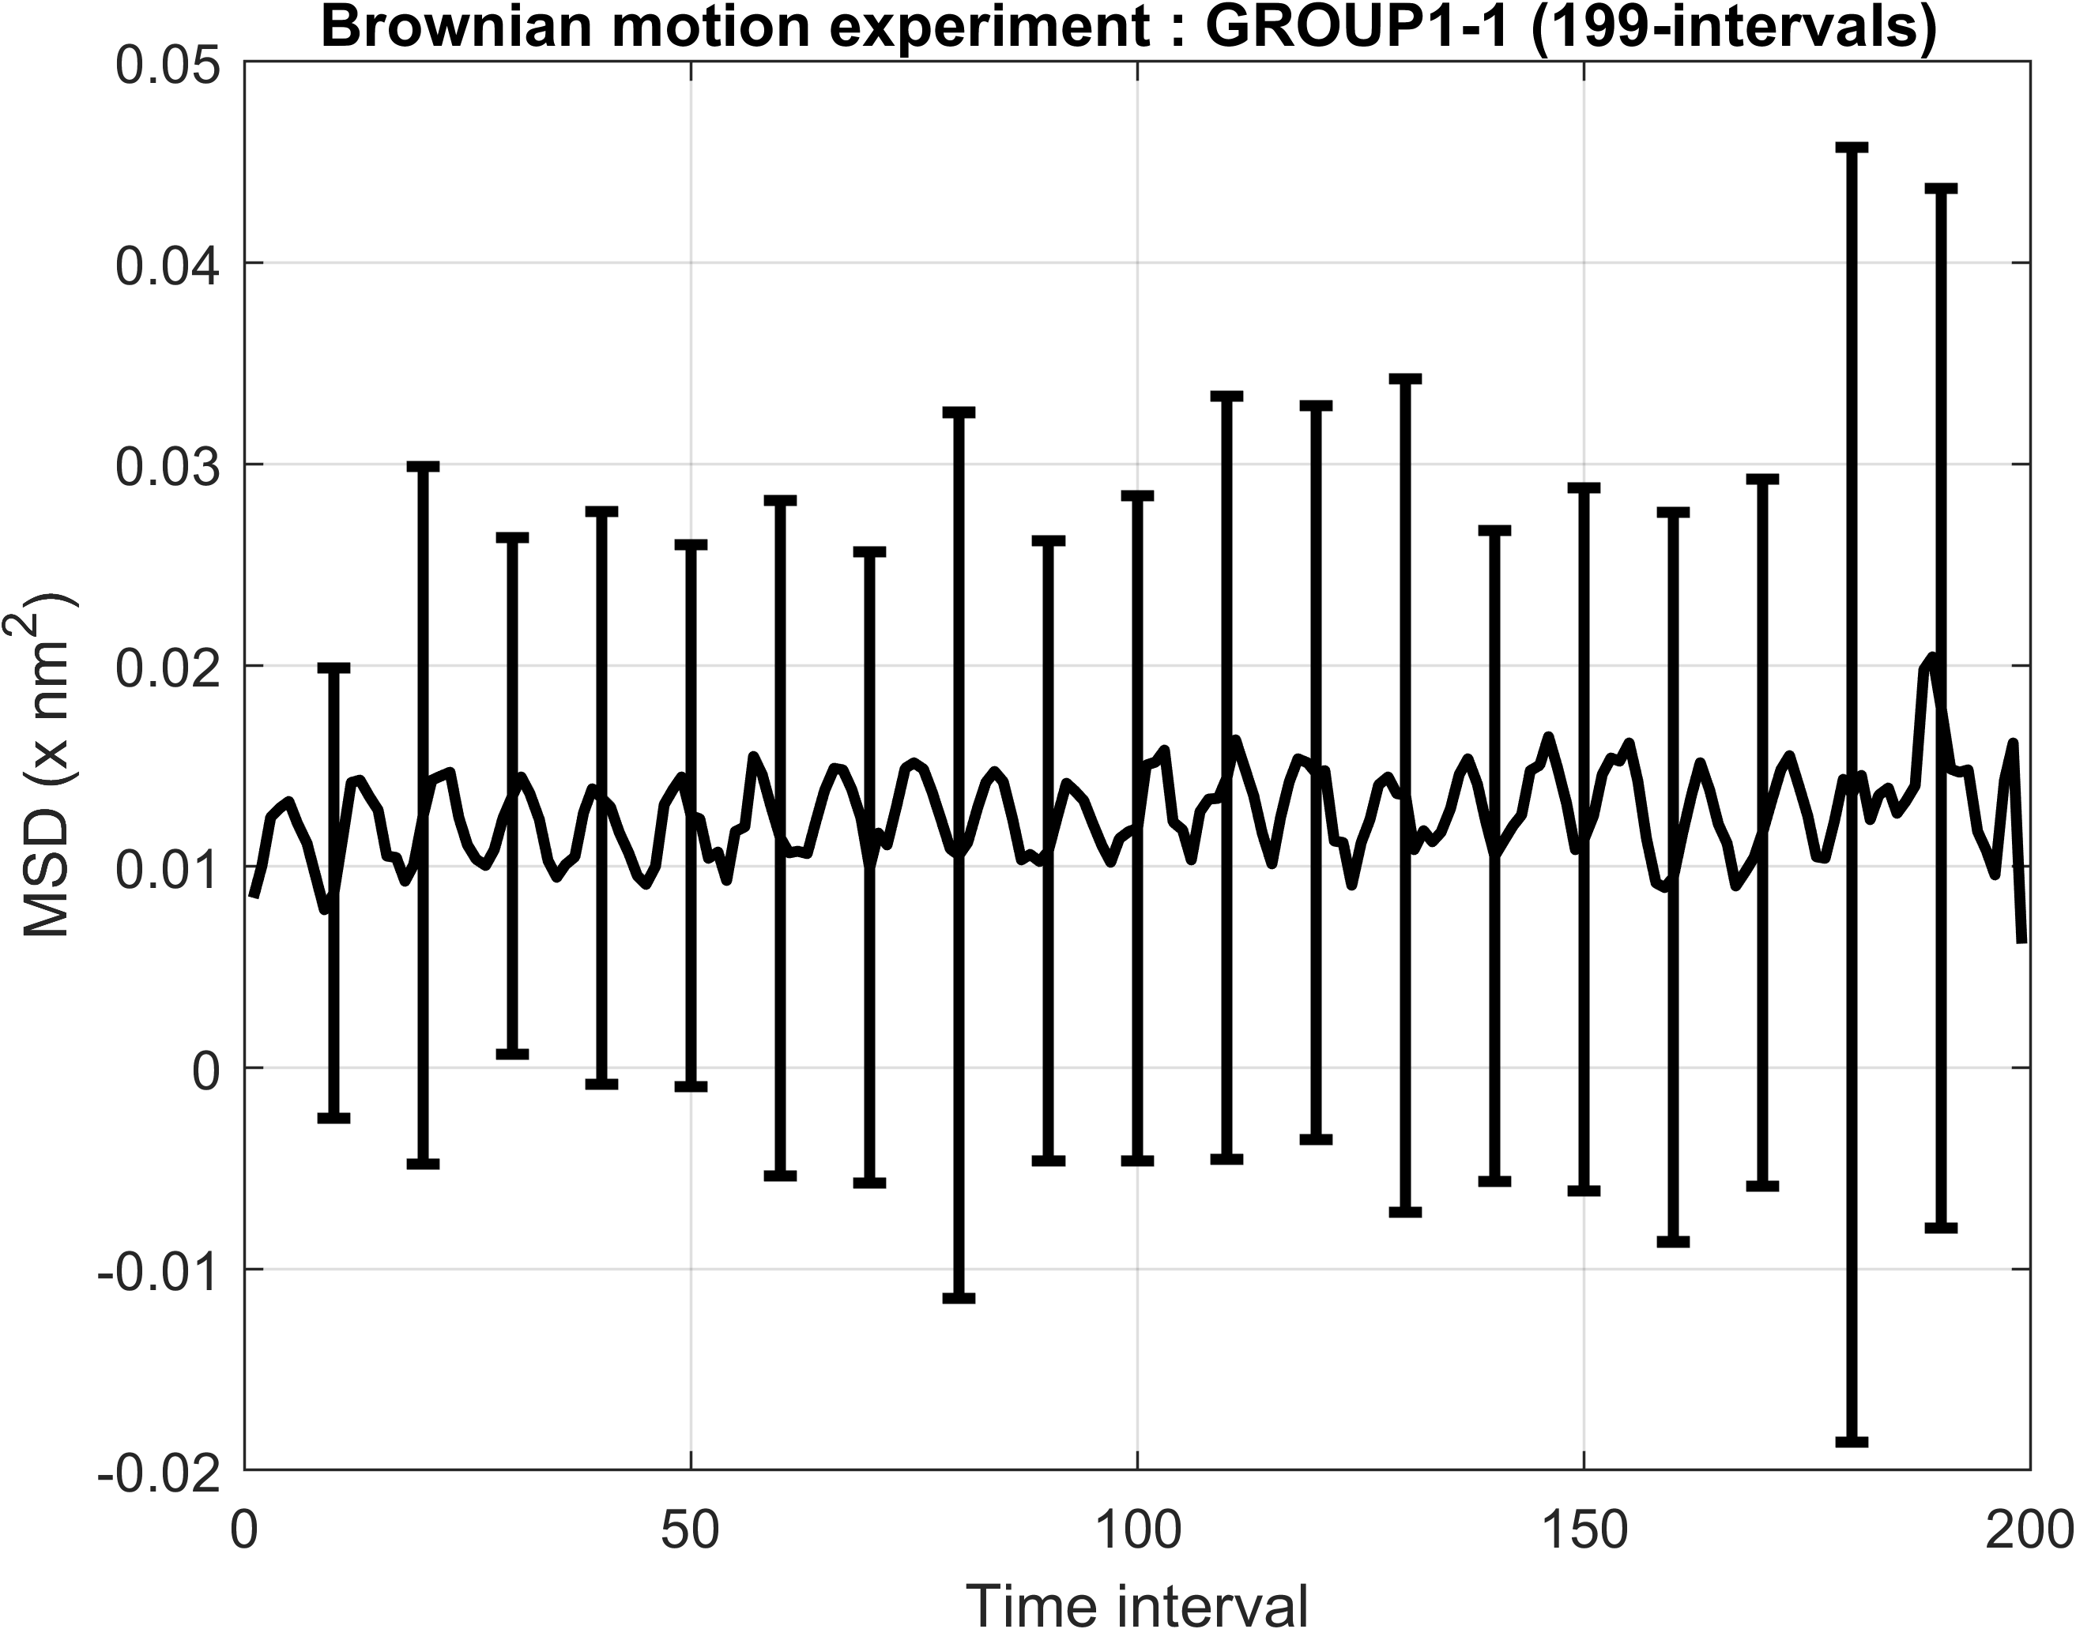
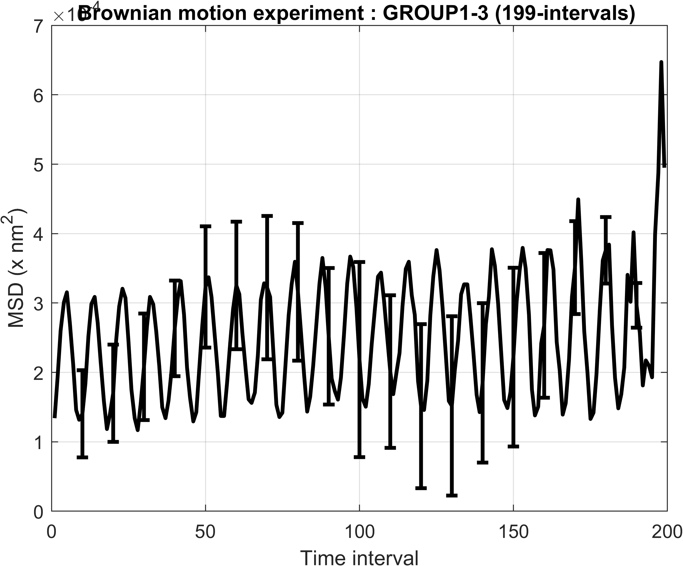
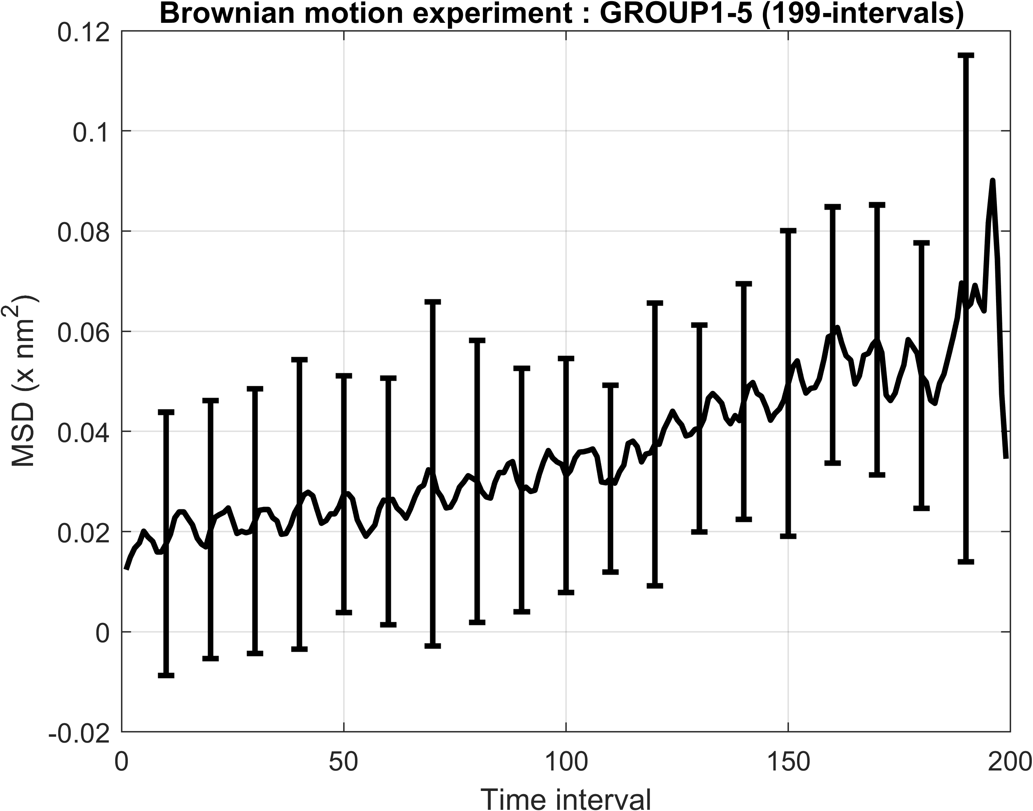

Slide 9
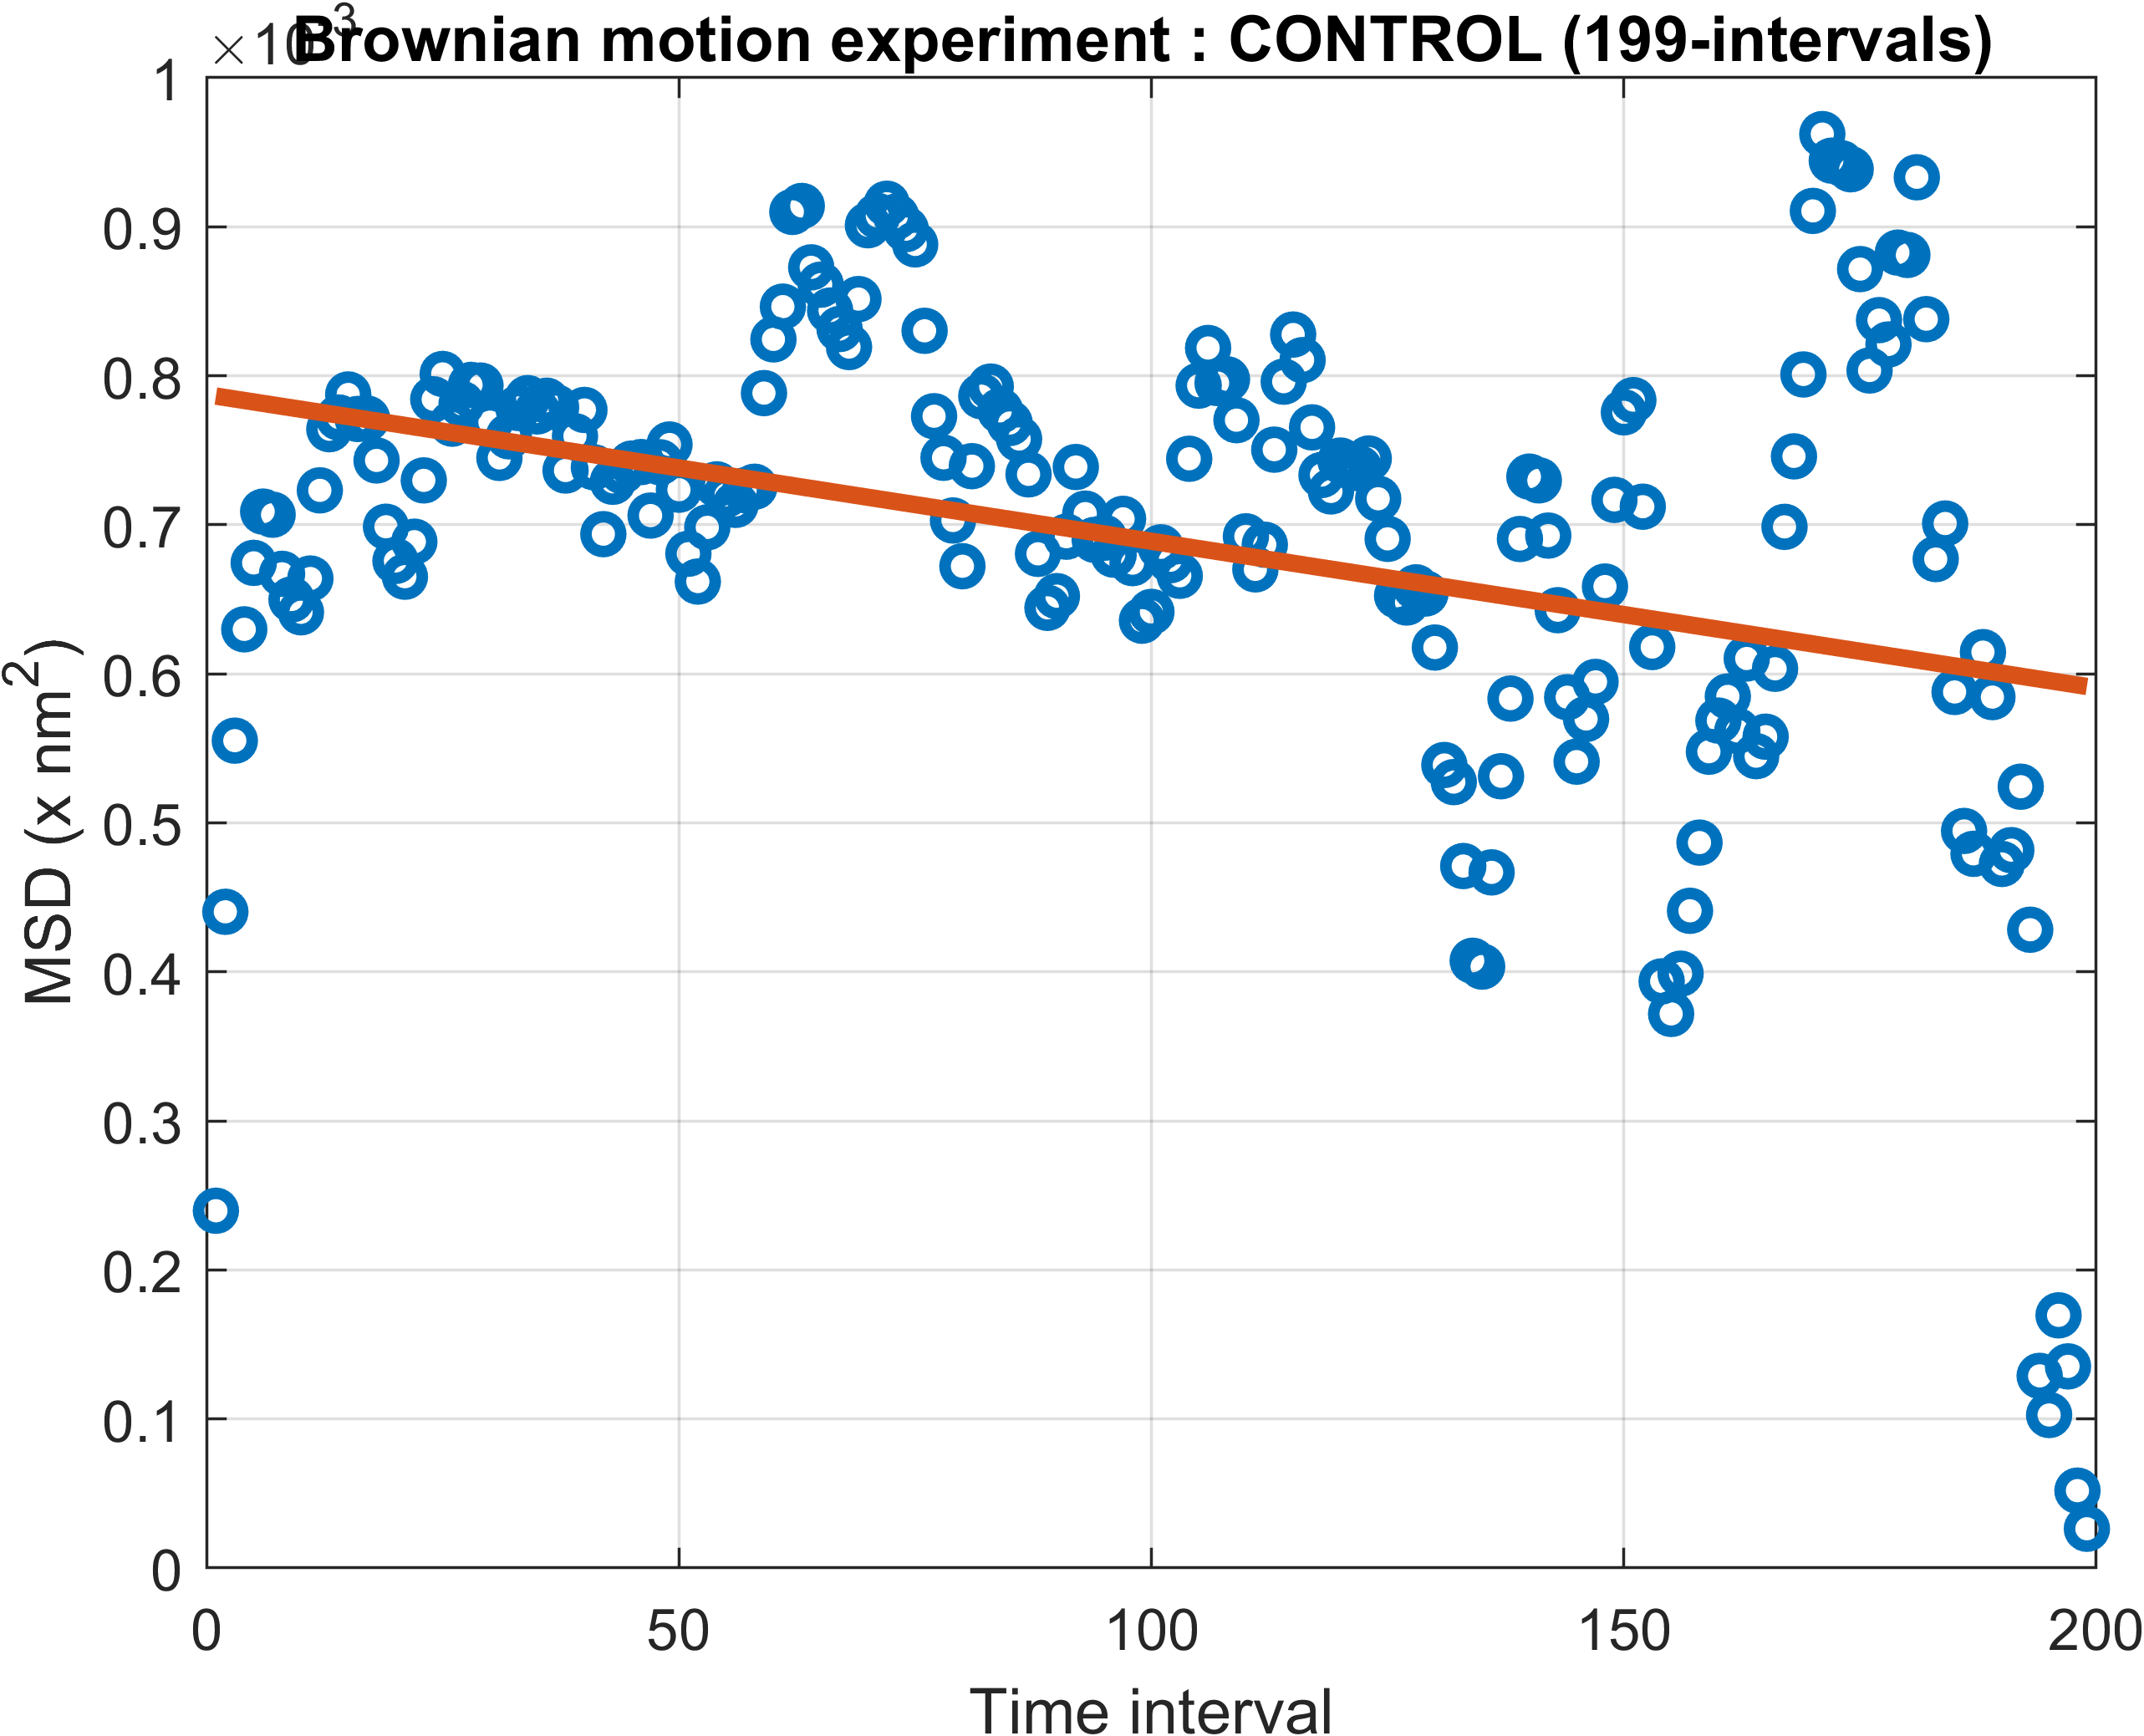
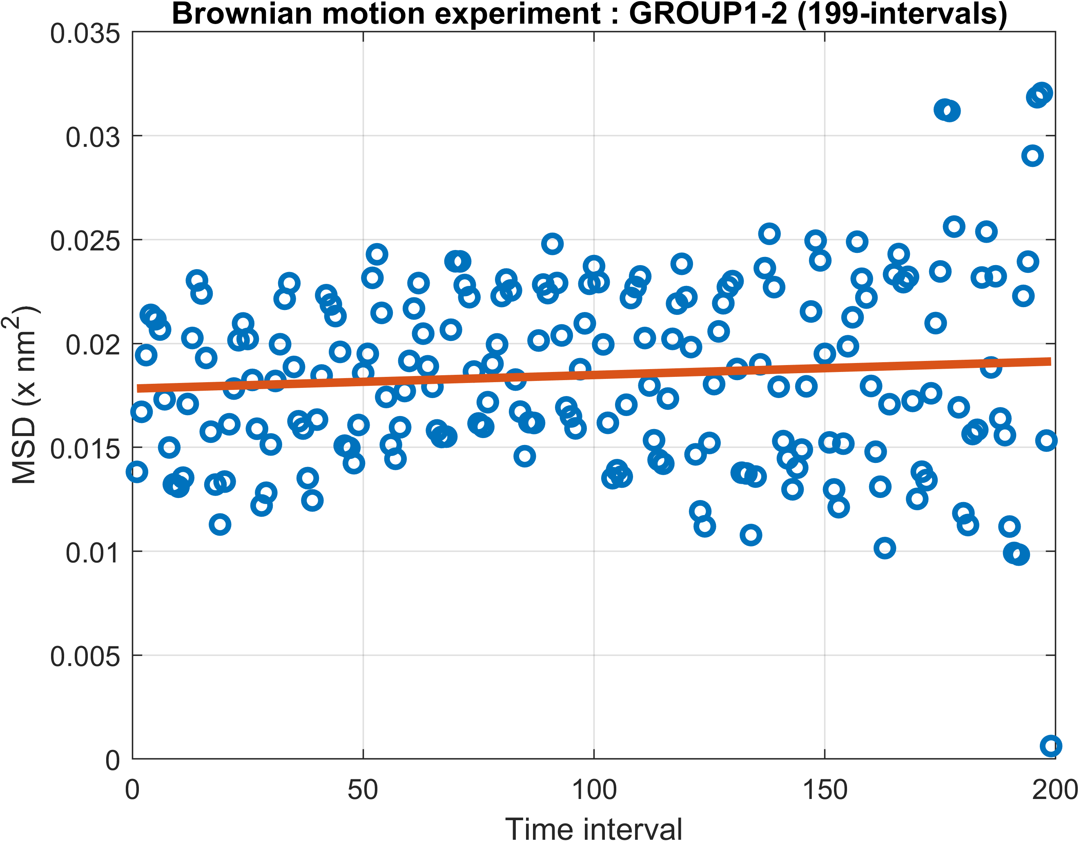
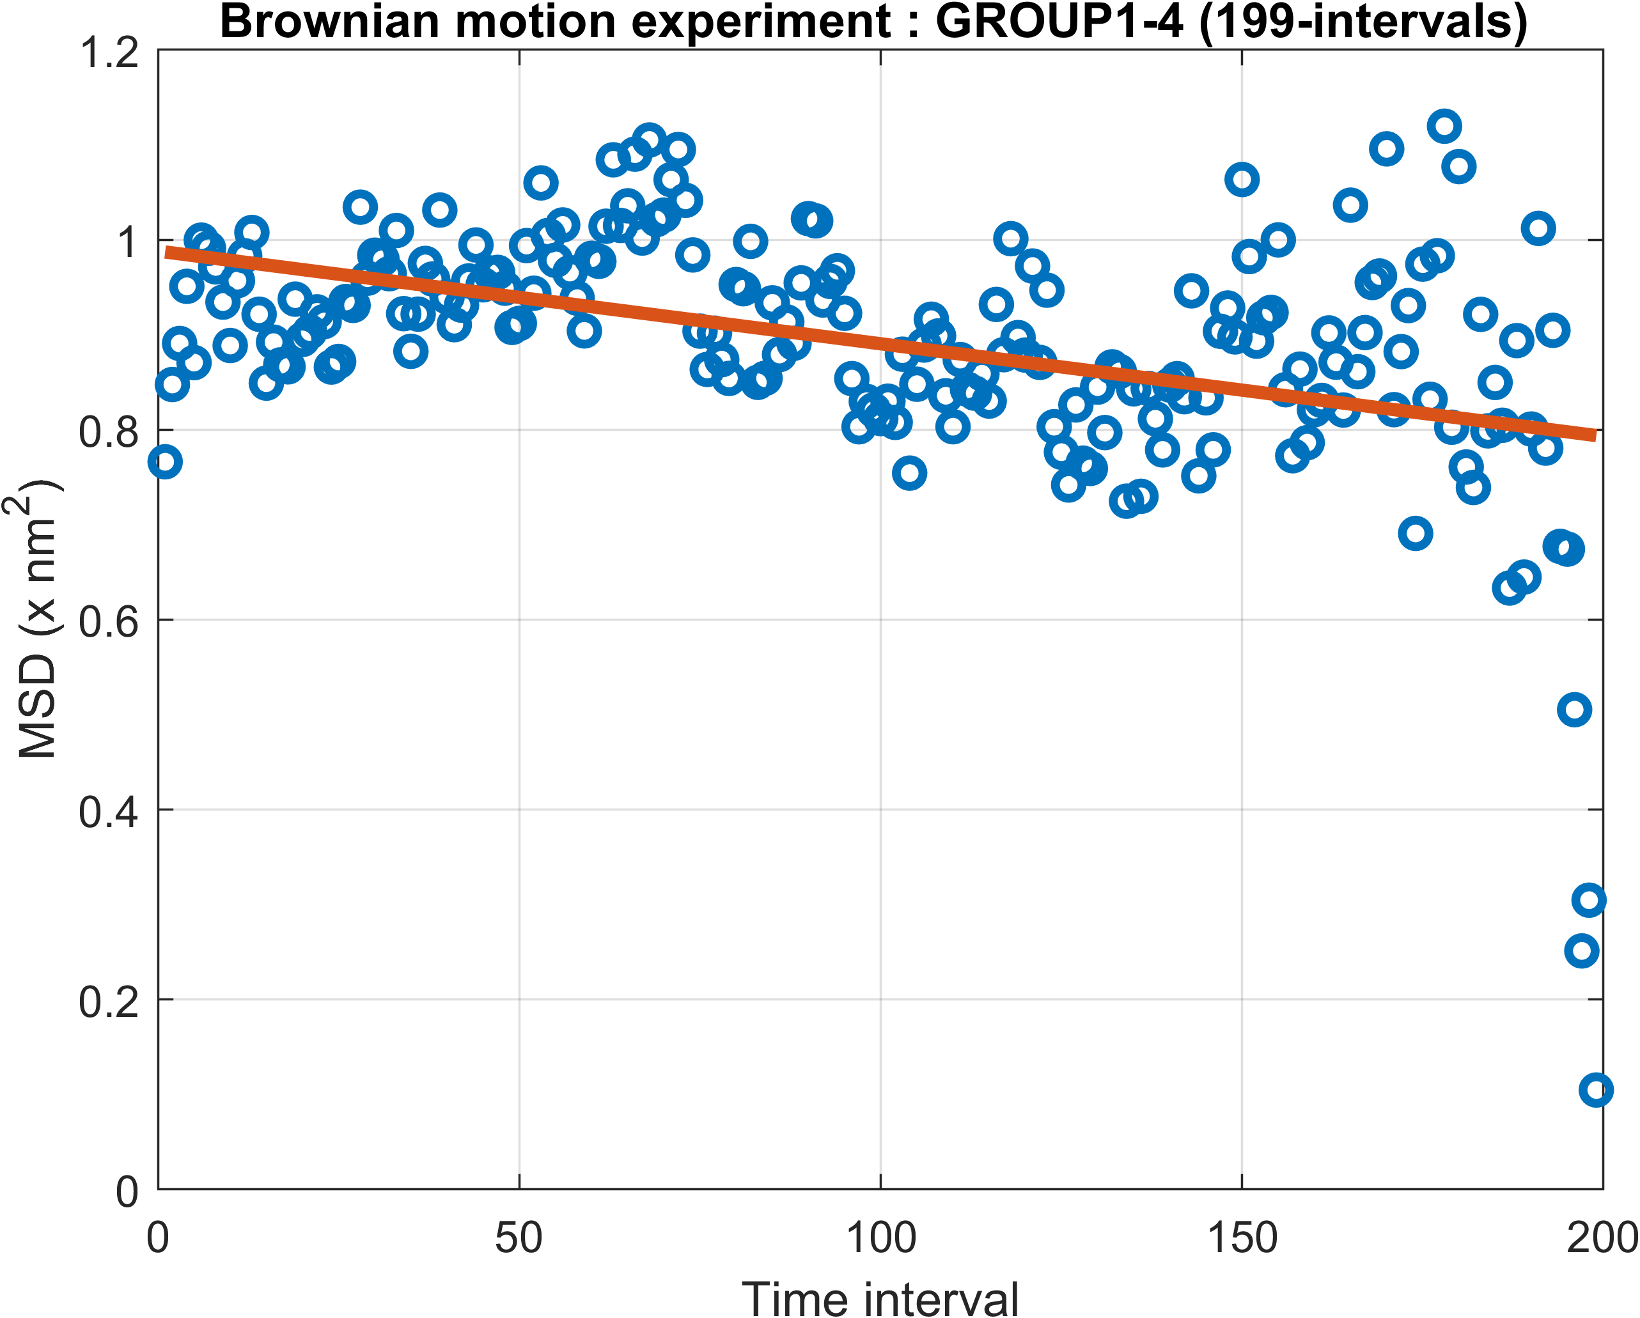
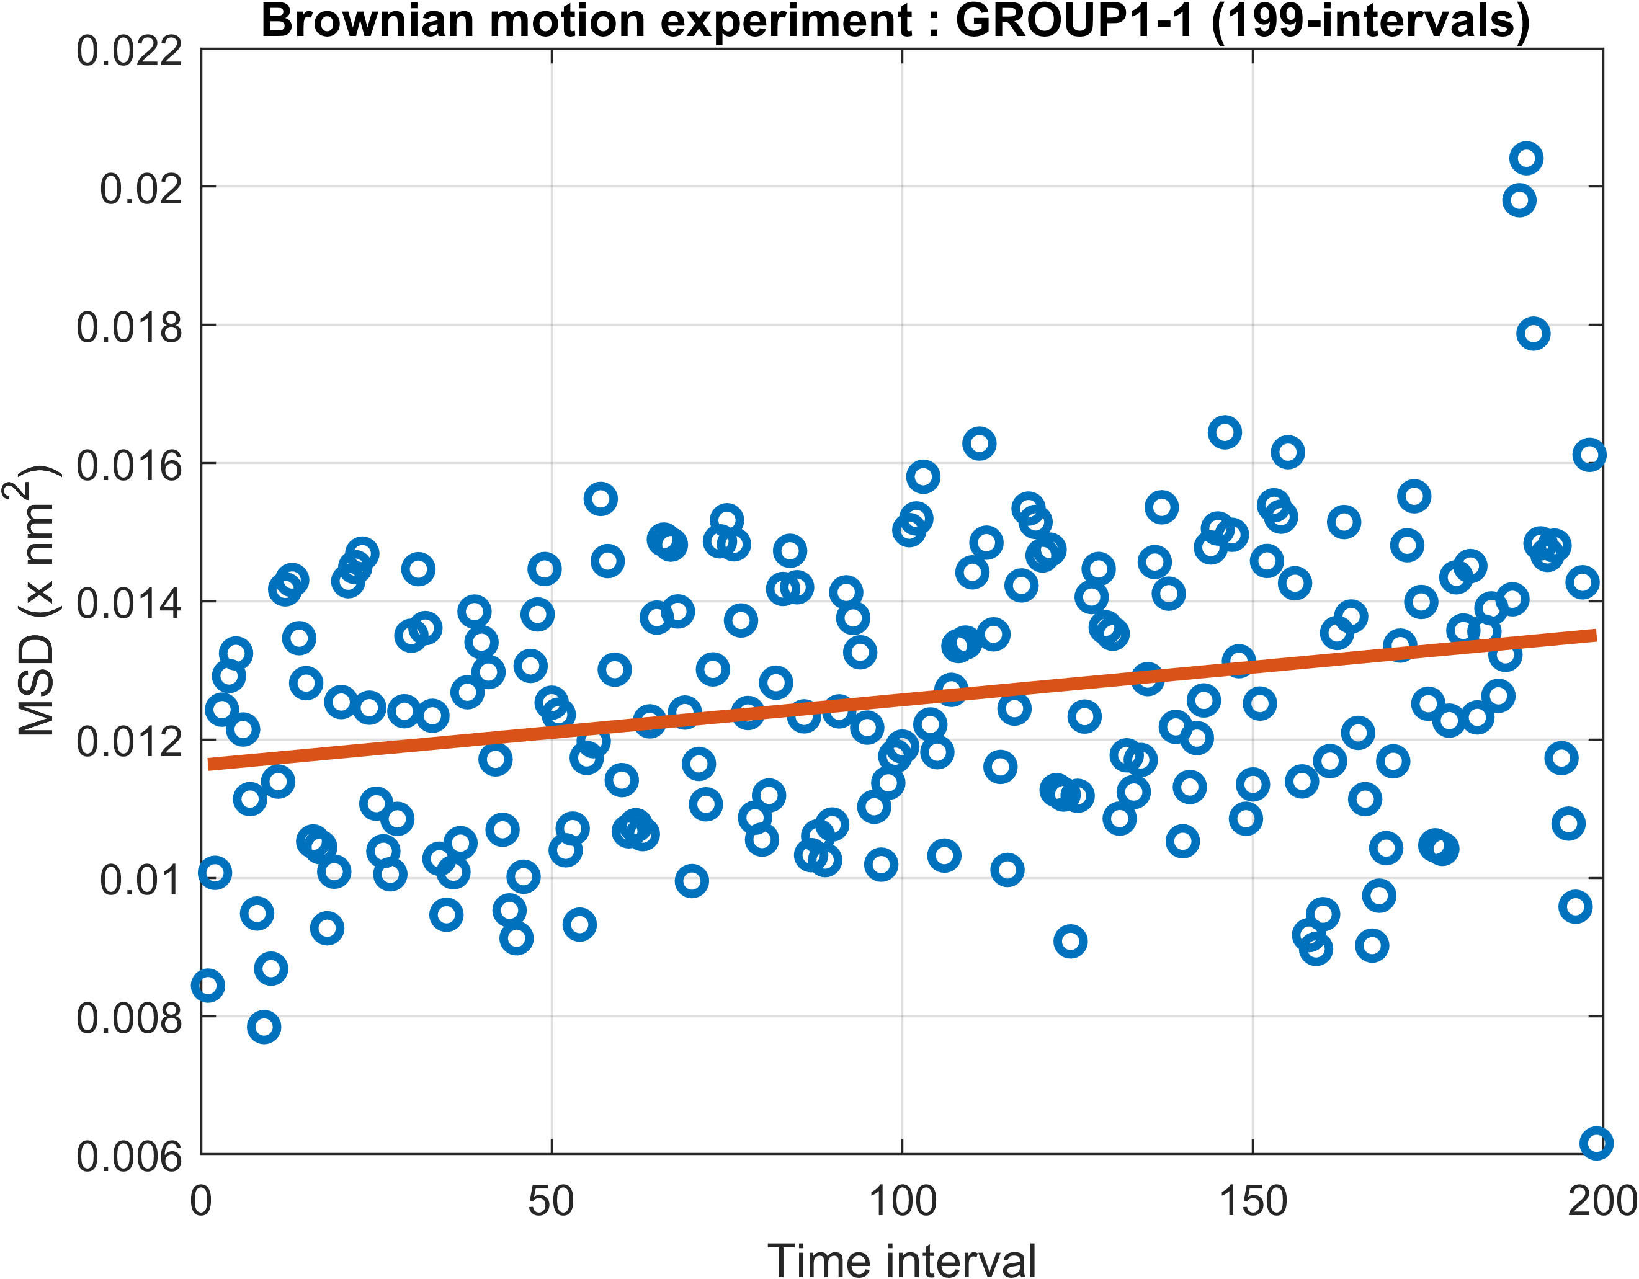
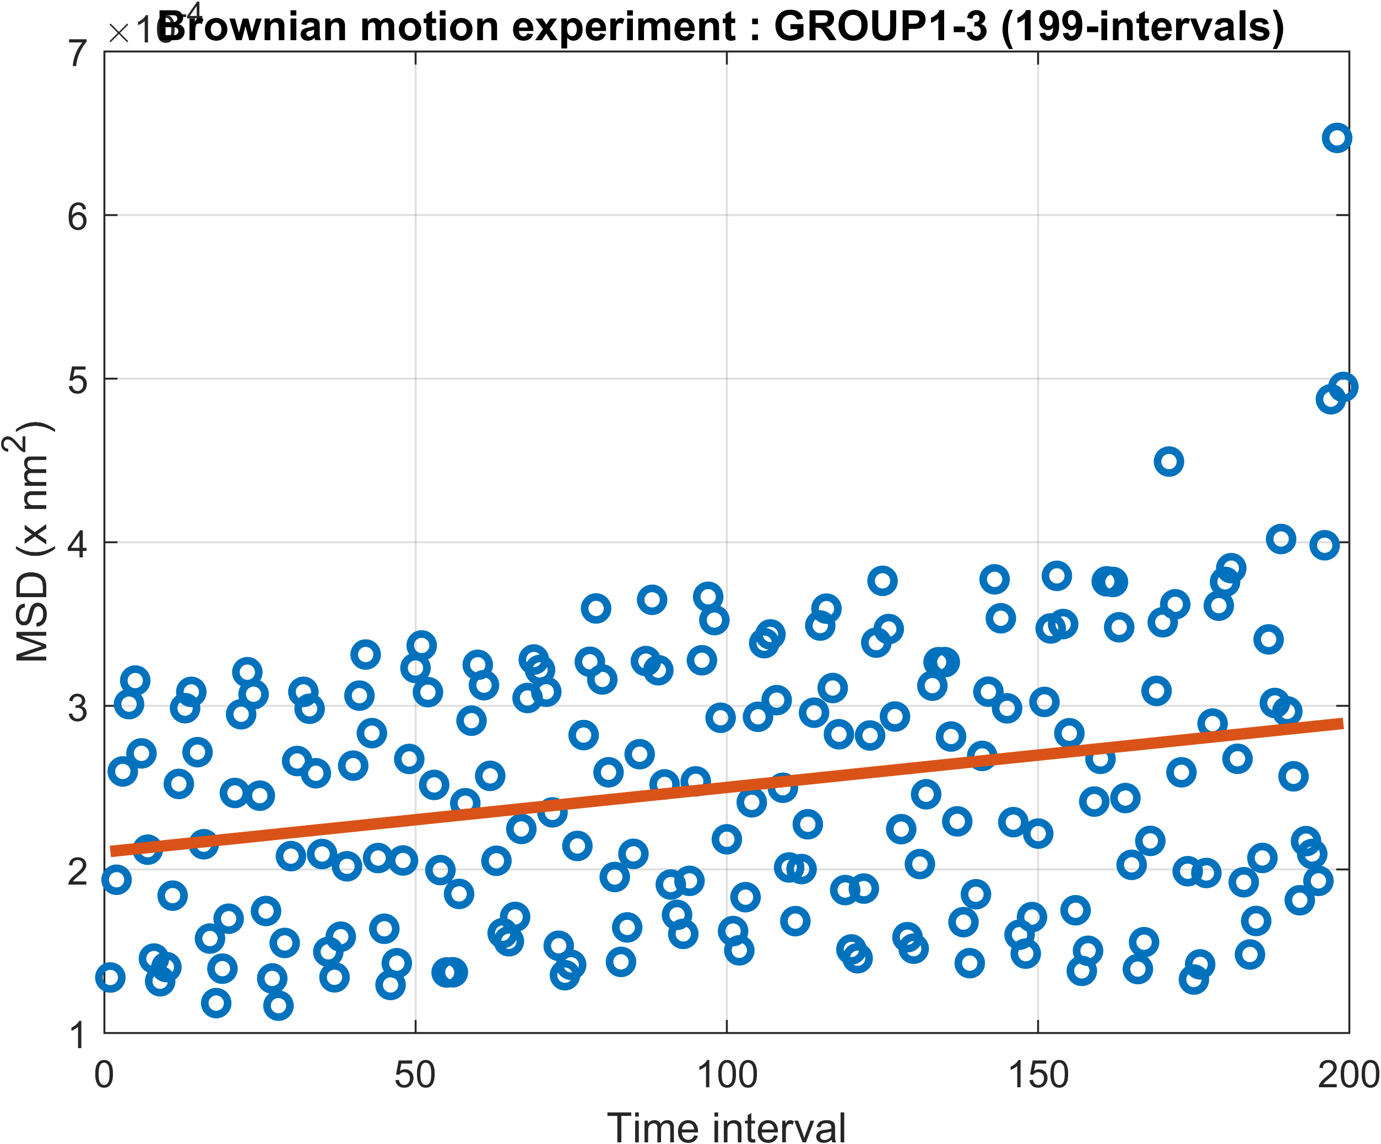
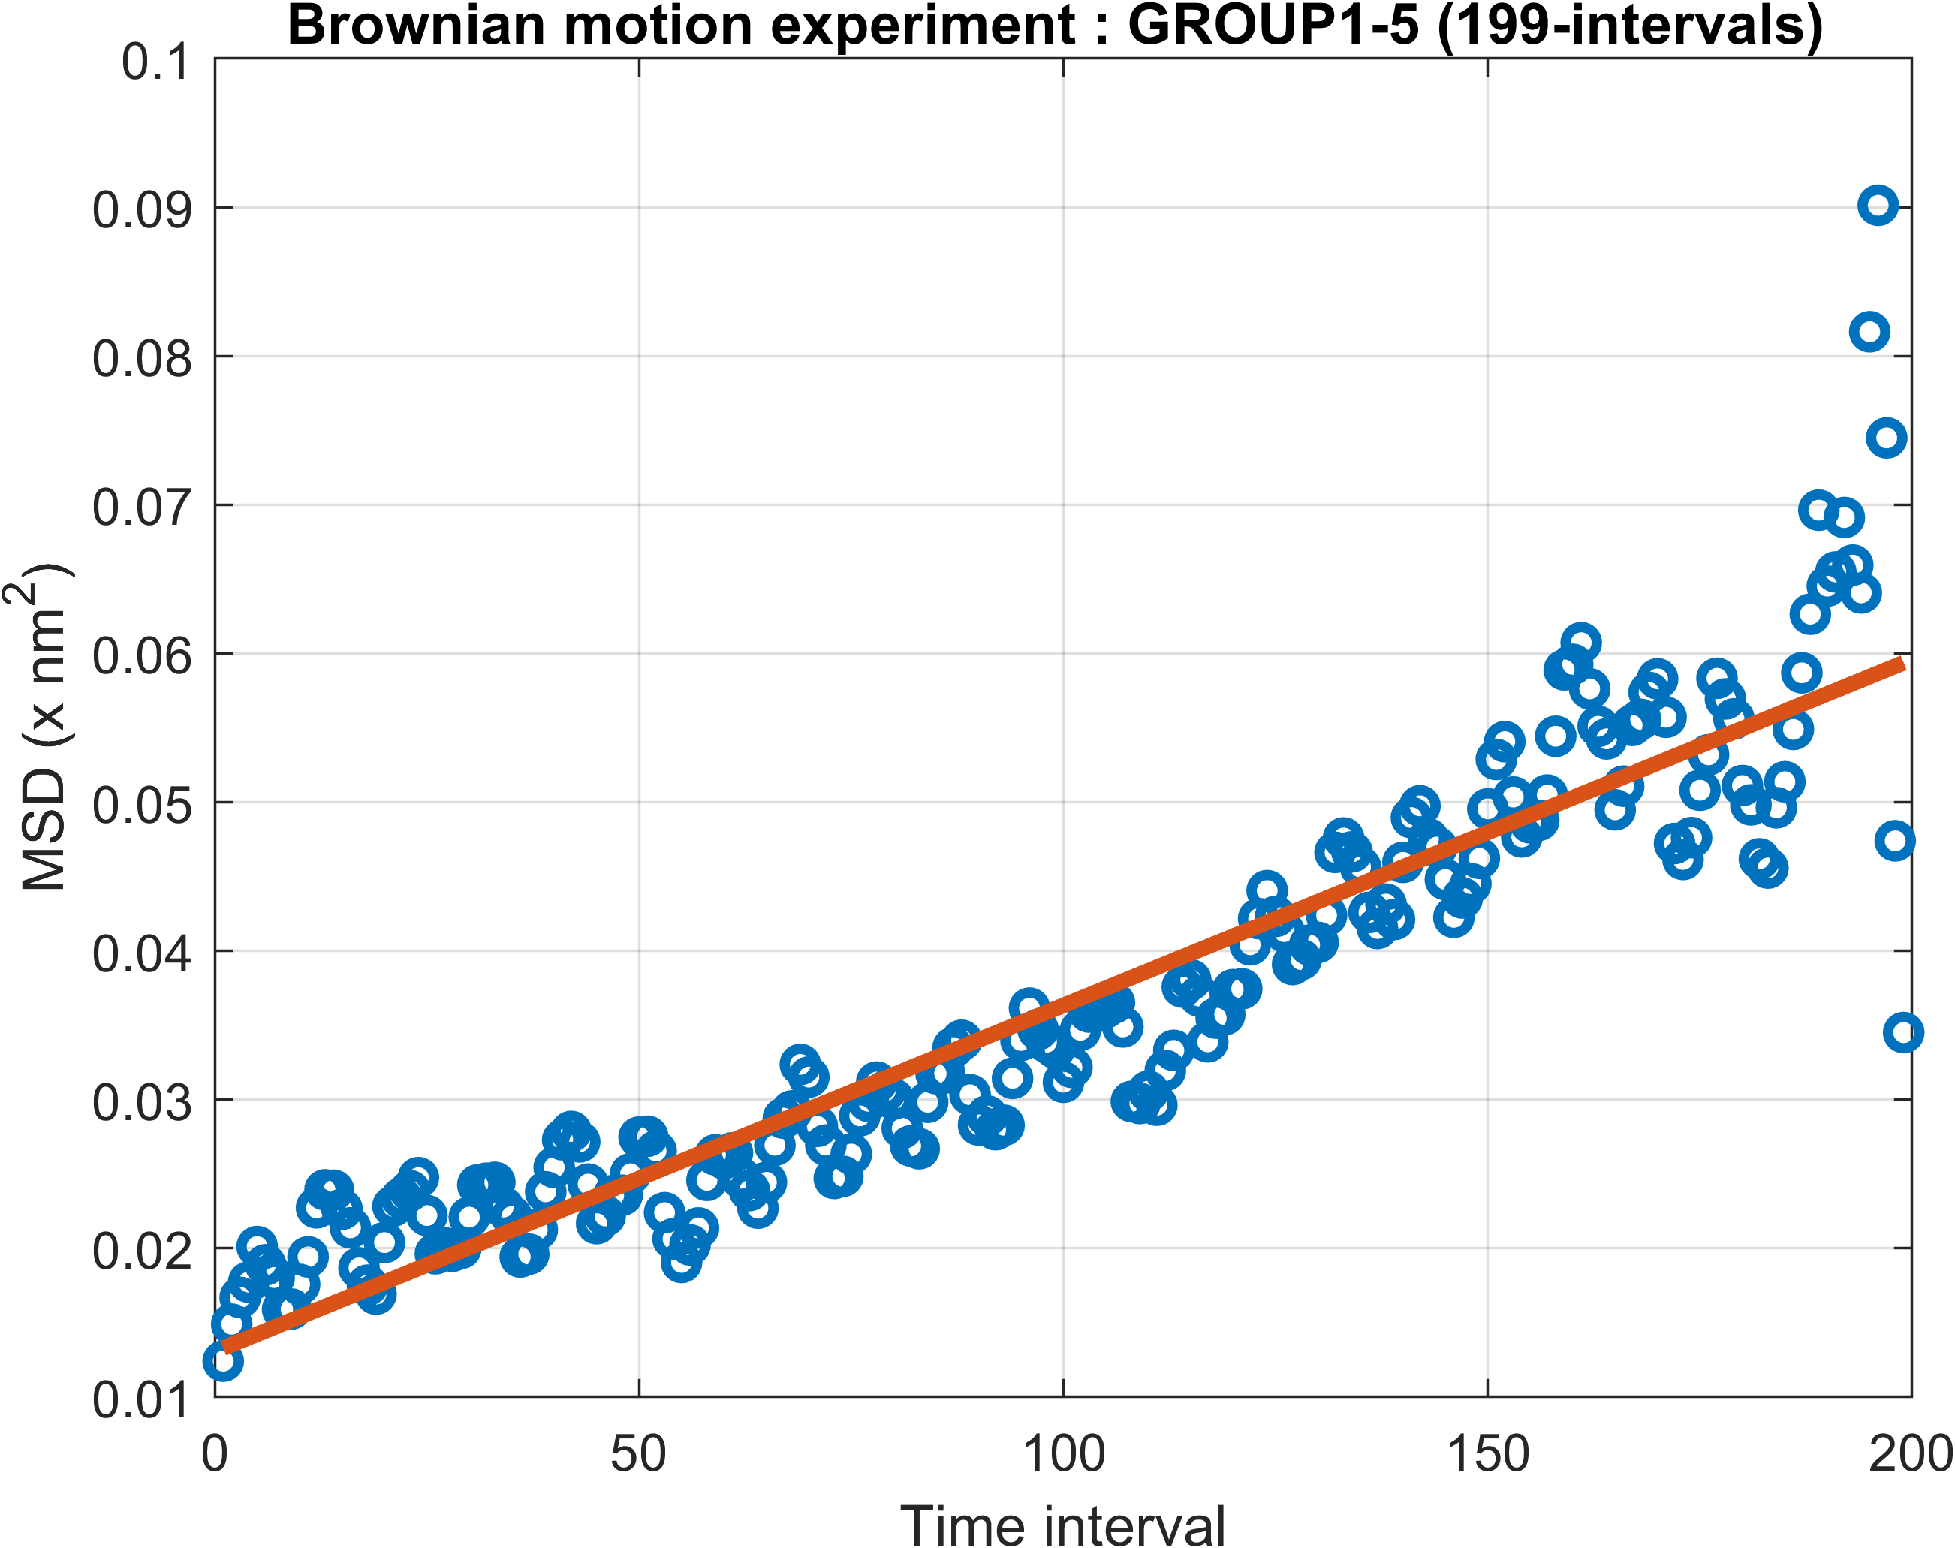

Slide 10
